Slide 1
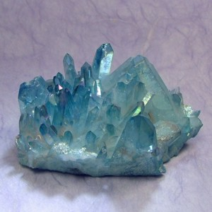


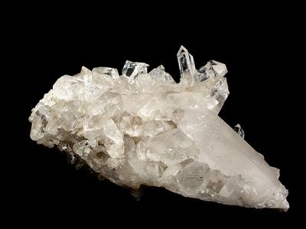

Logo Design Ideas

Slide 2
Slogan Ideas
Your Golden Investment
A tiny step to a Golden Investment
A golden steal
E-Shop for Gold Coins & Jewellery
Gold Coins & Jewellery
Collectable Gold Coins in a Click
Gold Collections in a Click
No Slogan

Slide 3






Favicon Ideas

